Slide 1
The Coordinate Plane
Review of Plotting & Reading Coordinates
© 2021 M. Cherise Harrington All rights reserved

Slide 2
Content Objective: I will be able to identify the parts of a coordinate plane, plot points and record coordinates of a point on a coordinate plane.
Language Objective: I can name the parts of the coordinate plane including the x and y axes, origin, quadrant I, II, III & IV and describe how to plot a point.

Slide 3
English
Spanish

Slide 4
Urdu
Dari

Slide 5
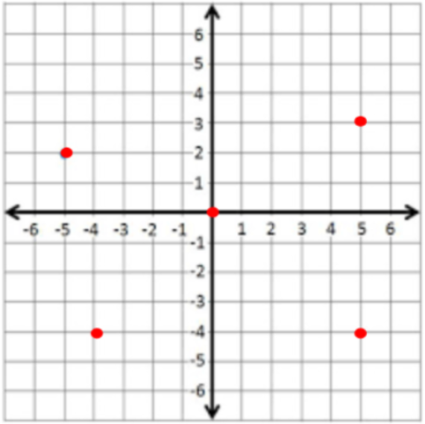
Coordinate Plane/Plano Coordinado
Directions: Drag each box to the label the correct place on the Coordinate Grid.
x-axis
Quadrant I
y-axis
Quadrant II
Origin
Quadrant III
(5 , 3)
Quadrant IV
(-5 , 2)
(0 , 0)
(-4 , -4)
(5 , -4)

Slide 6
Graphing from Coordinates
Coordinate Pairs
(x-coordinate, y-coordinate)
(-2 , -4)
(-1 , -2)
(0 , 0)
(1 , 2)
(2 , 4)
Is this line going up (positive) or down (negative) ?

Slide 7
Graphing from a Table
Table/Tabla:
x | y
-2 | 4
-1 | 2
0 | 0
1 | -2
2 | -4
Is this line going up (positive) or down (negative) ?

Slide 8
7th & 8th Grade
Coordinate Plane Practice
1st Click on the IXL icon & sign-in, then click on the Titles to get the link
Quadrants & Axes Level 1 | Quadrants & Axes Level 2
Coordinates Level 1 | Coordinates Level 1

Slide 9
Content Objective: I will be able to identify the parts of a coordinate plane, plot points and record coordinates of a point on a coordinate plane.
Language Objective: I can name the parts of the coordinate plane including the x and y axes, origin, quadrant I, II, III & IV and describe how to plot a point.

Slide 10
After completing the Independent Practice, drag the circle to the emoji that best describes how you feel about your understanding of this lesson, then, list what you learned and what you are still having trouble with.
(Use as much mathematical terminology as possible from the learning targets.)

